Slide 1
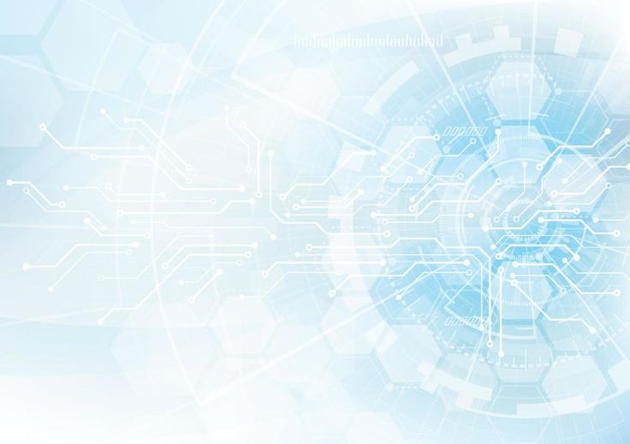
Real-time isl interpretation and parkinson's tremor correction with ar support.
Group members:
Iqra Ansari
Nusaybah Kazi
Jamil Khatri
Project Guide:
Er. Farhana Siddiqui

Slide 2
introduction
Tremor correction mechanism for people sufferering from parkinson's disease along with hearing impairability.
Parkinson's disease tremors make gestures recognition difficult.
ISL is used by 1.5 million people in India.
Integration of Computer vision , Machine learning and AR for practical usability.

Slide 3
Motivation
Communication barriers isolate hard of hearing and mute people from the society.
Indian sign language is not widely understood by the general population.
Parkinson's disease patients face hand tremors, this reduces gesture accuracy of the current available softwares.
There is a need for a system that ensures clear and reliable communication between individuals .
Our aim is to empower differently abled individuals .

Slide 4
OBJECTIVES
To correct hand movements for parkinson's patients for accurate recognition.
To integrate Augumented Reality for interactive and user-friendly interface.
To improve quality of life for differently abled individuals using innovative tools.
To interpret Indian sign language gestures into text , speech and regional languages spoken across India.

Slide 5
Literature review
ASPECTS | PAPER 1 | PAPER 2 | PAPER 3 | PAPER 4 | PAPER 5
AREA | Indian sign language using mediapipe. | Indian sign language using deep learning. | Application of computer vision for tremor based analysis. | Validity of tremor analysis using cv framework | AR in Indian sign language.
Method and technology | Mediapipe, CNN , LSTM | CNN based vision | Mediapipe, 3D motion capture | Mediapipe vs Apple vision | AR virtual interpreter.
Drawbacks | Limited dataset, Only covers basic letters. | Focused on static gestures only. | Requires controlled camera setup. | Tested only in lab-like condiotions. | Not widely tested.
Year of Publication. | 2023 | 2025 | 2023 | 2023 | 2023

Slide 6
Methodology
FRONTEND | BACKEND
Login and authentication. | Preprocessing Engine- Filters and tremor corrections.
2. Camera interface for capturing ISL. | 2. Machine learning models for isl Interpretation.
3. Real-time AR overlay- shows text/speech output and tremor corrections. | 3. Database- Stores user profile , gestures and logs.
4. Built using futter / React Native for cross platform mobile support. | 4. API – Connects frontend with recognition engine.

Slide 7
LOGIN AND AUTHENTICATION
FLOWCHART
User opens app
Choose login method
[Username+ password]
Validate credentials
[Face login]
Success=home/dashboard
Failure=error message

Slide 8
REAL-TIME AR OVERLAY
FLOWCHART
Camera input
Hand and gesture detection
Apply tremor correction
Generate speech output
Overlay AR text on screen
Recognize ISL gesture

Slide 9
conclusion
Developing a system for real-time Indian sign language to text/speech interpretation with multi-lingual support.
Integrating tremor corrections for parkinson's patients.
Added Augumented reality support for interactive and user-friendly feedback.
System helps bridge the gap between signers ann non-signer community of India.

Slide 10
references
Velmathi, g,& Goyal,K. Indian sign language recognition using mediapipe Holistic.arXiv:2304.10256.[2023]
Singhal ,R,Gupta ,J.,Sharma ,A.,Gupta & Sharma,N. Indian sign language detection for real time translation using machine learning. ArXiv:2507.20414.[2025].
Fredrich,M.U.,Roenn.,A,-J., Palmisano,C.,Alty, J., Muthuraman.,M Peach, R., &RIECH,M.M. Validation and applicationof computer vision algorithms for video-based tremor analysis.[2023]
Bungay, J., Emokpae, O., Relton, S. D., Alty, J., Williams, S., Fang, H., & Wong, D. C. . Contactless hand tremor amplitude measurement using smartphones: development and pilot evaluation. arXiv:2304.14937.[2023].
Pizzuto, E., et al Towards Incorporating 3D Space-Awareness into an Augmented Reality Sign Language Interpreter .[2023].

